Slide 1
College Admission Agent ( RAG Based )
IBM HACKATHON PROJECT
Presented By
Student name : Paras Deepak Sheth
College Name: Dr. Babasaheb Ambedkar Technolgical University Lonere, Maharashtra
Department : Electronics and Telecommunications Engineering

Slide 2
OUTLINE
Problem Statement
Technology used
Wow factor
End users
Result
Conclusion
Future scope
IBM Certifications

Slide 3
Problem Statement
Students often face delays in getting answers to their queries. Traditional support systems (email, helpdesk) are time-consuming. Lack of real-time academic and administrative guidance. Need for a smart, scalable, and always-available solution.

Slide 4
Technology used
IBM cloud lite services
Natural Language Processing (NLP)
Retrieval Augmented Generation (RAG)
IBM Granite model

Slide 5
IBM cloud services used
IBM Cloud Watsonx AI Studio – NLP-based chatbot creation
IBM Cloud Watsonx AI runtime
IBM Cloud Agent Lab
IBM Granite foundation model

Slide 6
Wow factors
24/7 Smart Student Support using AI Natural Language Understanding for better query handling Multi-language support (Optional) Scalable across all institutions under DTE Reduces human workload significantly

Slide 7
End users
Students – For academic and campus-related help
Faculty and Staff – To redirect common queries to the bot
DTE Rajasthan – For centralized student support management

Slide 8
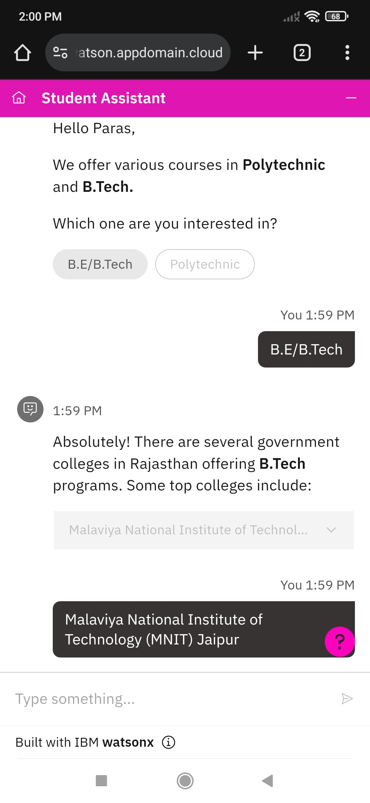
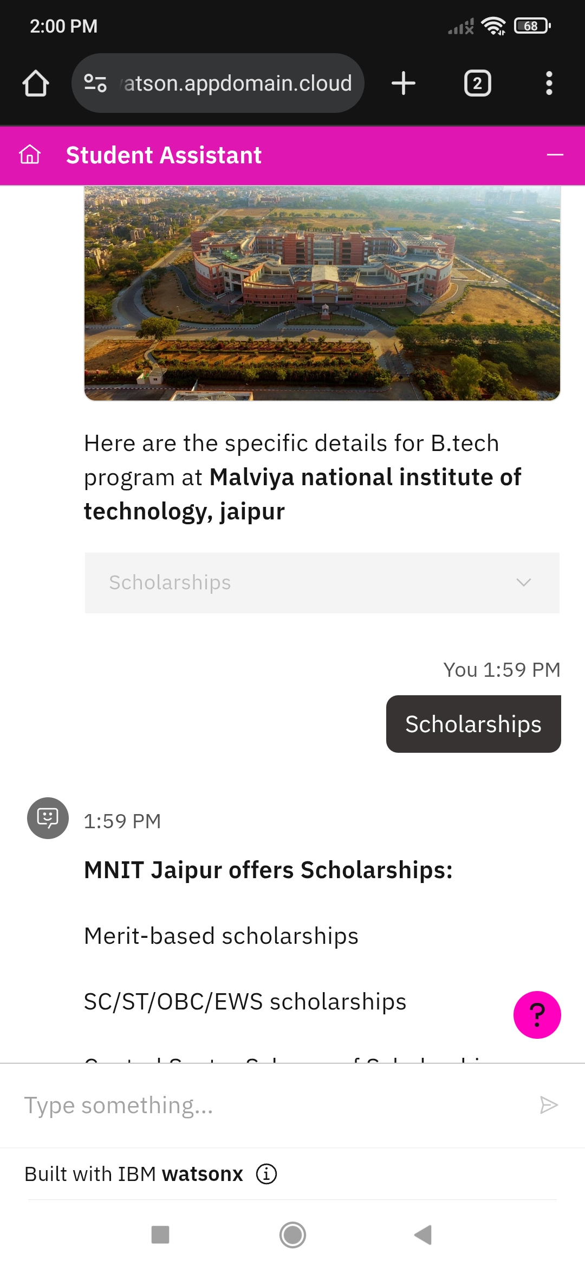
Results

Slide 9
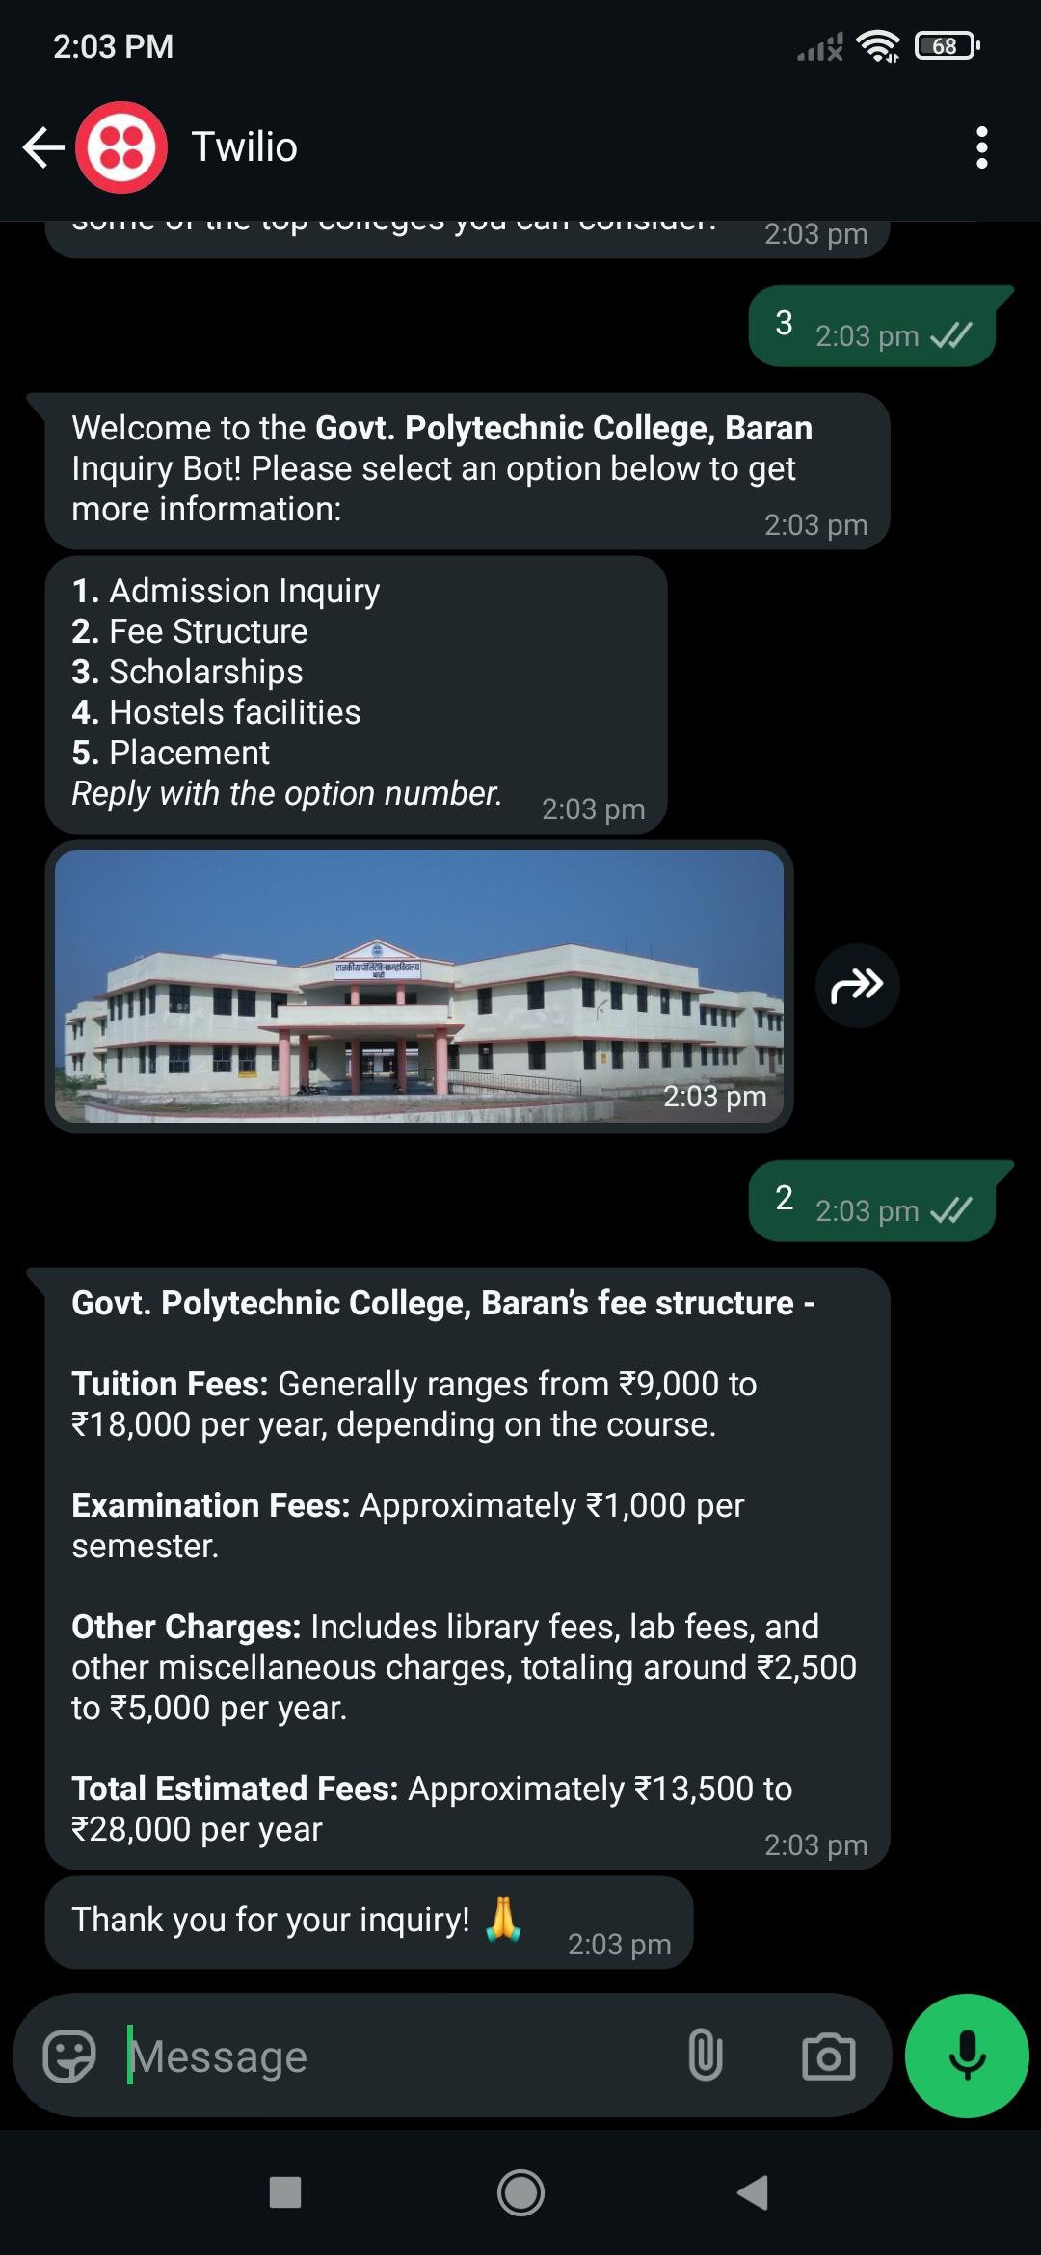

Results

Slide 10
Conclusion
The chatbot provides a seamless support experience to students.
Enhances communication between students and administration.
Demonstrates how AI can automate and improve student services.

Slide 11
Future scope
Integrate with student management systems (ERP)
Add voice assistance using IBM Watson Speech APIs
Deploy across mobile platforms (Android/iOS apps)
Expand to other departments/universities

Slide 12
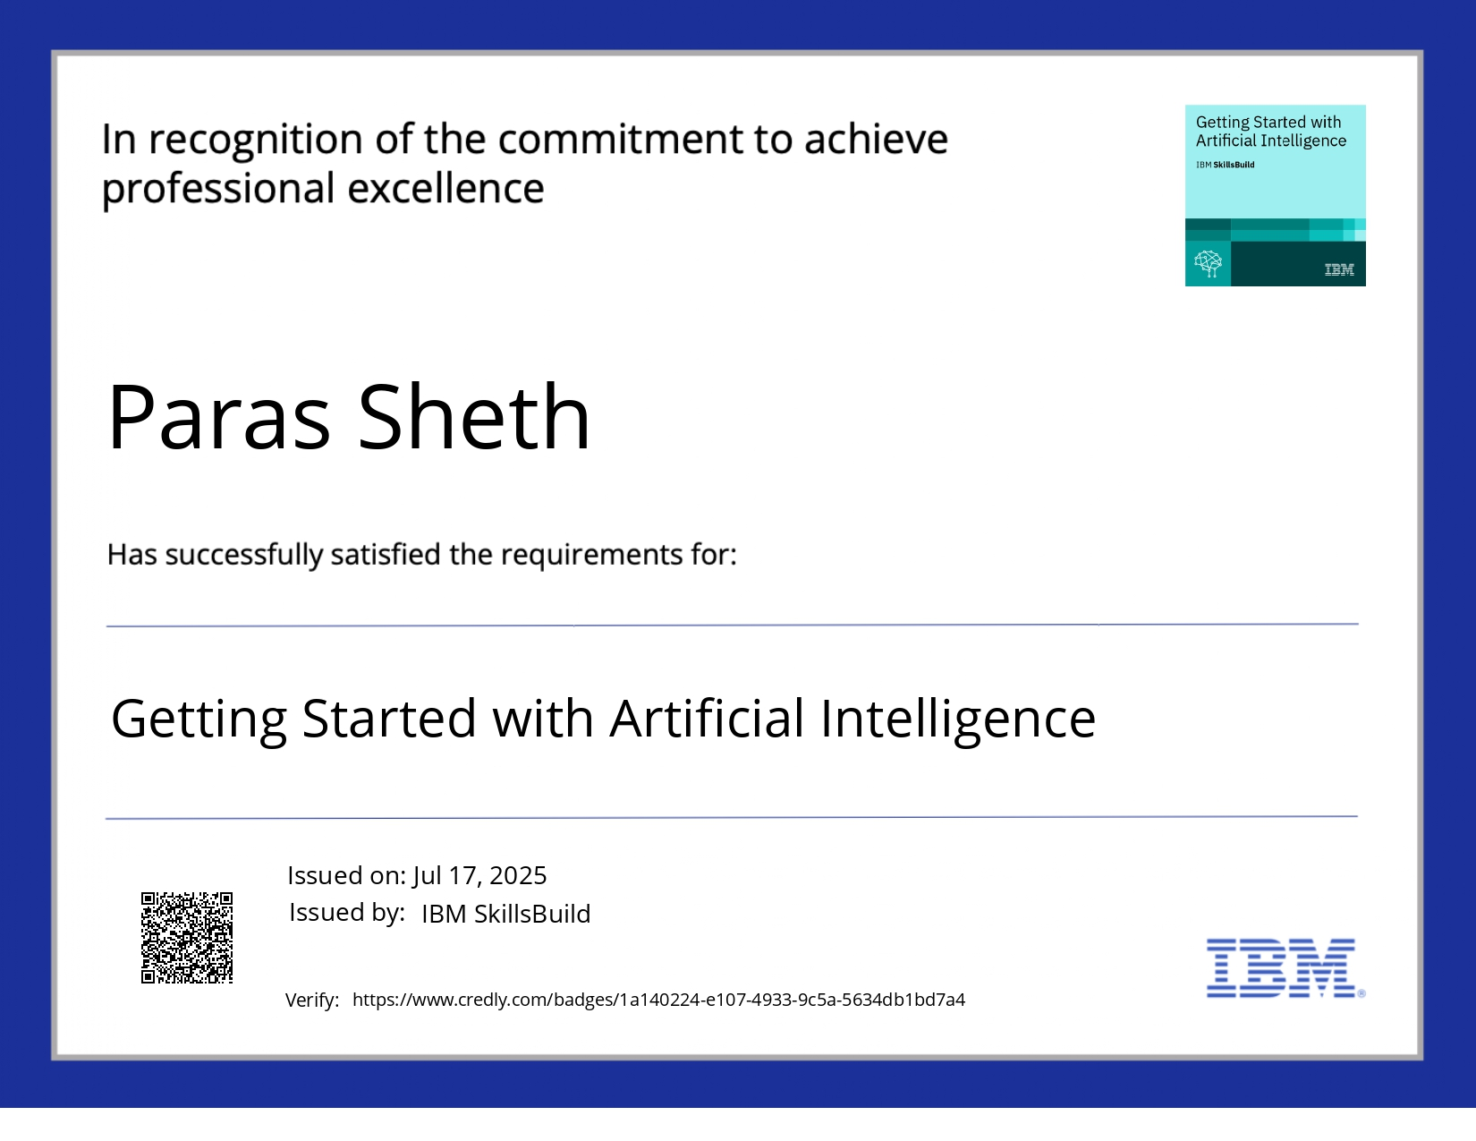
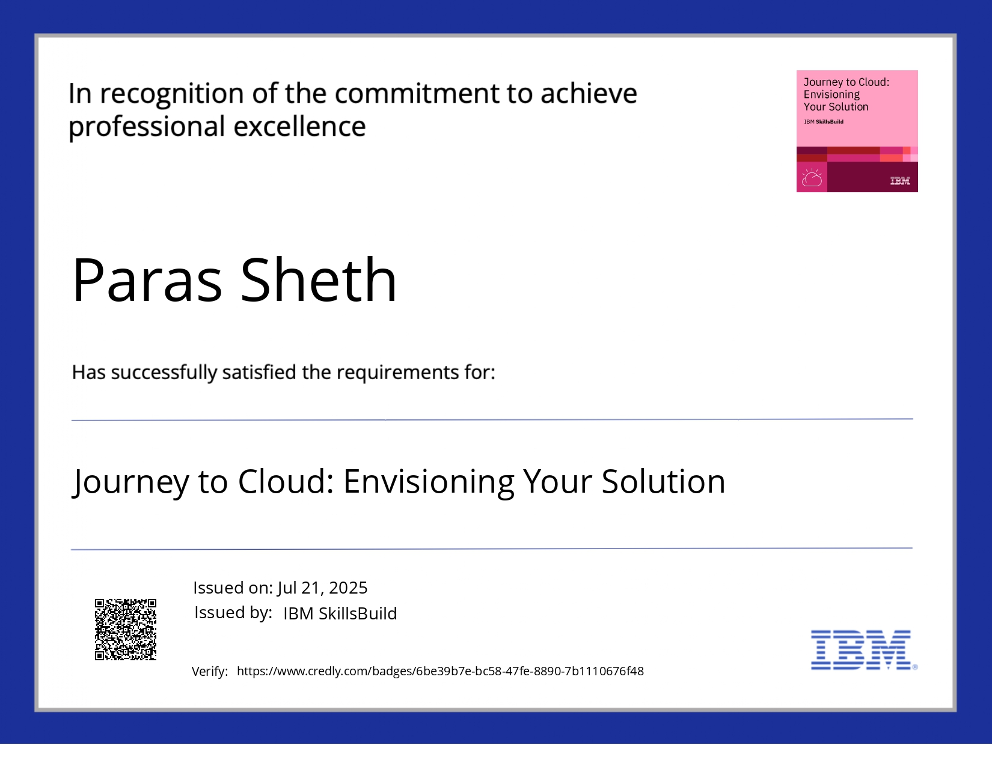
IBM Certifications

Slide 13
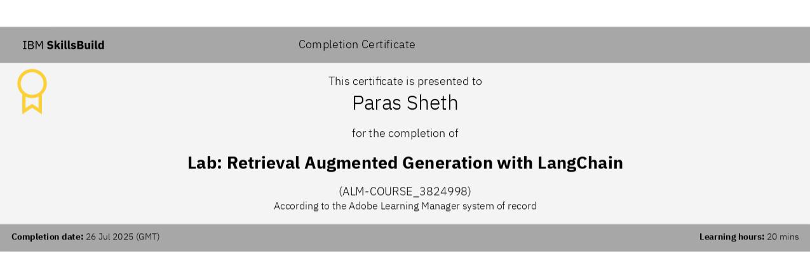
RAG LAB certificate

Slide 14
THANK YOU

